Slide 1
Progressive Web App Day 1
Hilman Ibnu Assiddiq

Slide 2
Outline
Getting Started
Understanding App Manifest
The Service Workers
Promise and Fetch
Service Workers - Caching
Service Workers - Advanced Caching
IndexedDB and Dynamic Data

Slide 3

Hilman Ibnu Assiddiq
Software Developer at Bandung Techno Park (2014 - now)
Zend Framework 2 Certified Architect
Co-Founder SISCA
https://github.com/hilmania

Slide 4
Outline
Getting Started
Understanding App Manifest
The Service Workers
Promise and Fetch
Service Workers - Caching
Service Workers - Advanced Caching
IndexedDB and Dynamic Data

Slide 5
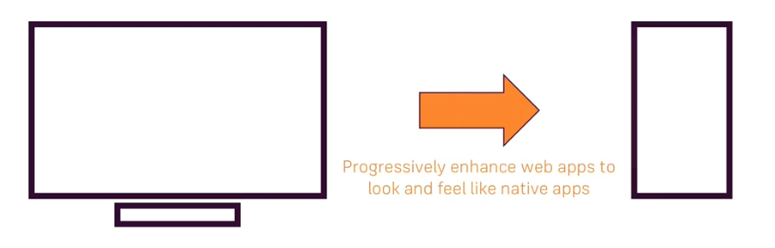
PWA?
What is Progressive Web Frameworks?
Be reliable : Load fast and provide offline functionality
Fast : Respond quickly to user actions
Engaging : Feel like a native app on mobile devices

Slide 6
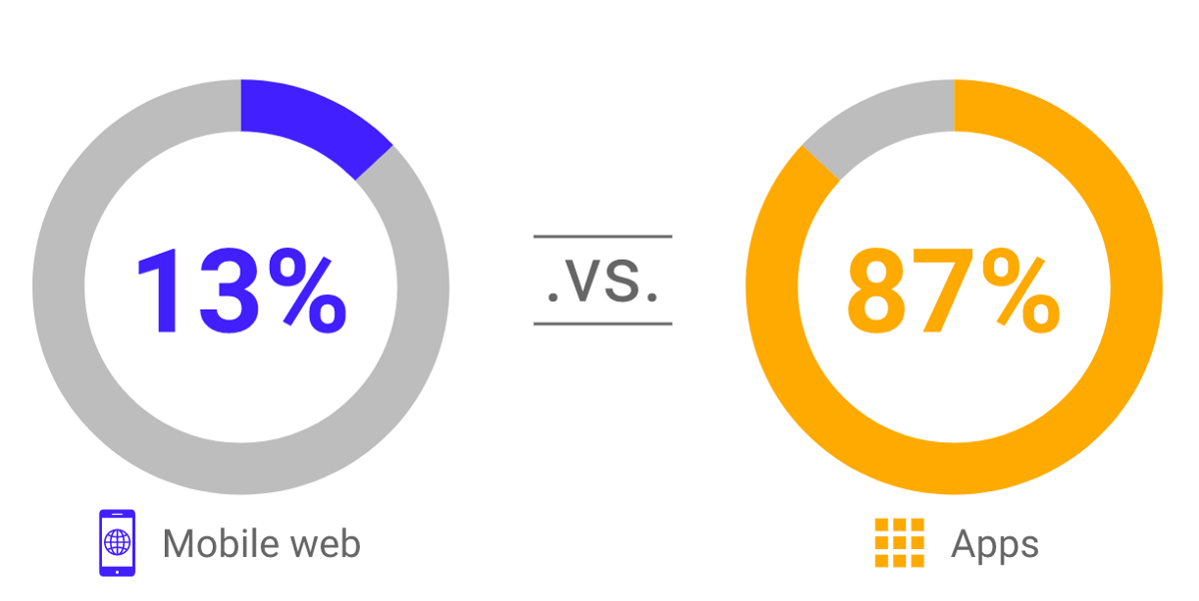
Mobile Web vs Native Apps
Push Notifications
Home Screen Icons
Possibly Work Offline
Access Native Device Features like Camera
Source : comScore Mobile Metrix 2018

Slide 7
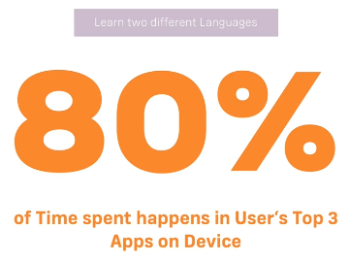
Do you really want to Build a Native App?
Source : comScore Mobile Metrix 2018

Slide 8
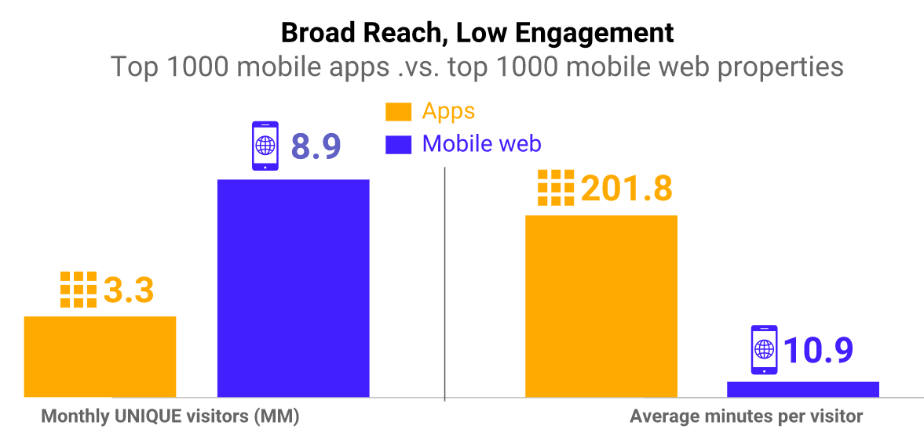
Reach of Apps vs Mobile Web
Source : comScore Mobile Metrix 2018

Slide 9
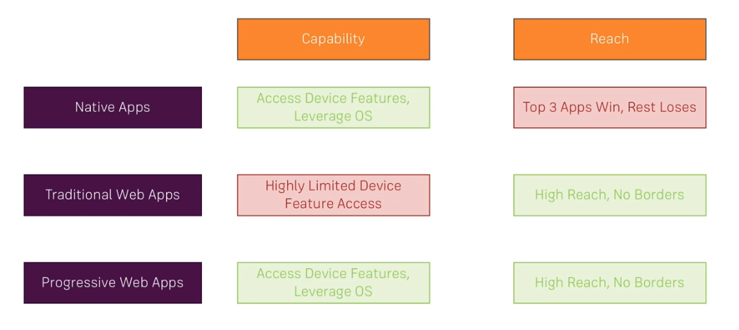
PWAs vs Native Apps vs “Traditional” Web Pages

Slide 10
Requirements
Google Chrome
NodeJS
Text Editor (Visual Studio Code, or others)

Slide 11
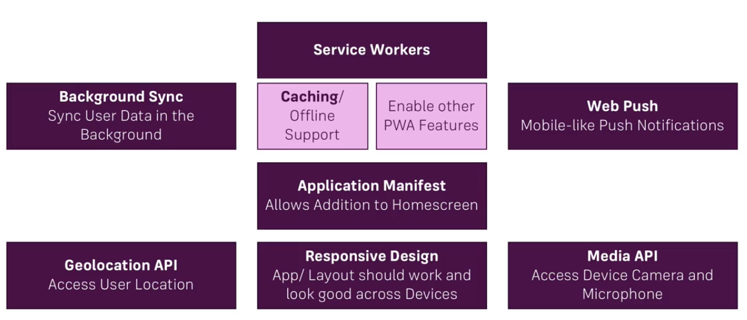
PWA Core Building Blocks

Slide 12
Outline
Getting Started
Understanding App Manifest
The Service Workers
Promise and Fetch
Service Workers - Caching
Service Workers - Advanced Caching
IndexedDB and Dynamic Data

Slide 13
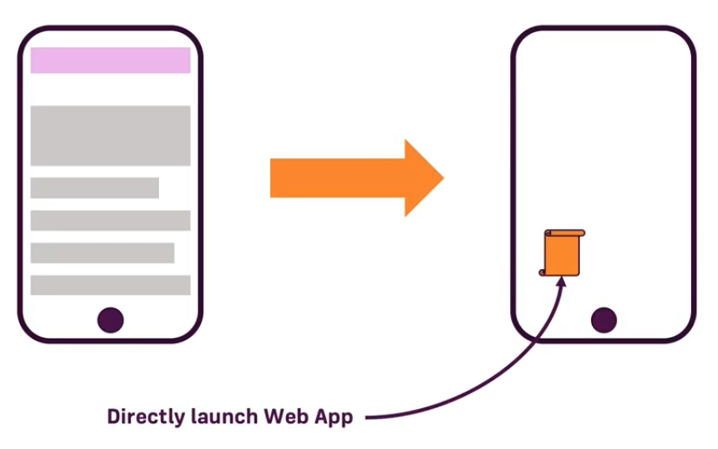
Web App Manifest
Make your web app installable

Slide 14

Manifest Properties
{
“name”: “Pemkab - PWA”,
“short_name”: “Pemkab”,
“start_url”: “/index.html”,
“scope”: “.”,
“display”: “standalone”,
“background_color”: “#fff”,
“theme_color”: “#3f51b5”,
“description”: “Pemkab APP”,
“dir”: “ltr”,
“lang”: “en-US”,
“orientation”: “portrait-primary”,
“icons” : [
{
“src”: “/src/images/icons/app-icon-48x48.png”,
“type”: “image/png”,
“sizes” : “48x48”
},
...
]

Slide 15
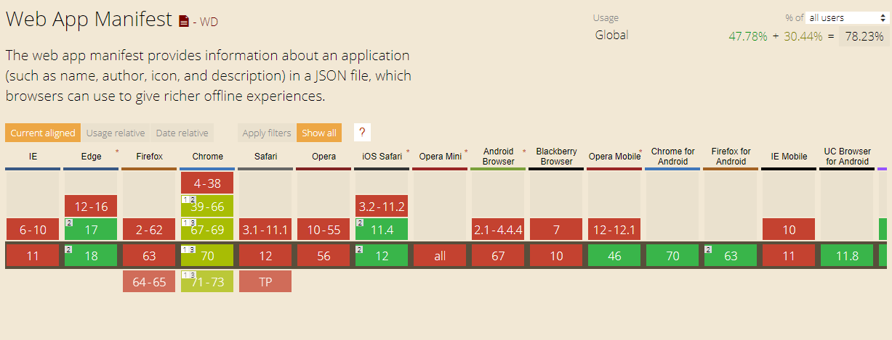
Support Browsers
https://caniuse.com/#feat=web-app-manifest

Slide 16
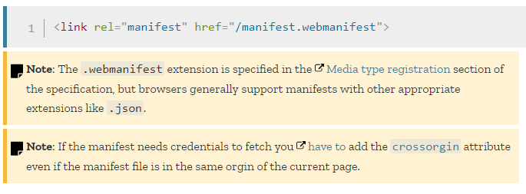
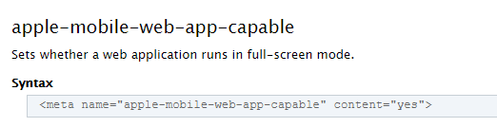
Deploy Manifest

Slide 17
Deploy Manifest (Safari)
<meta name="apple-mobile-web-app-status-bar-style" content="black">
<meta name="apple-mobile-web-app-title" content="AppTitle">
<link rel="apple-touch-icon" href="touch-icon-iphone.png">
<link rel="apple-touch-icon" sizes="152x152" href="touch-icon-ipad.png">
<link rel="apple-touch-icon" sizes="180x180" href="touch-icon-iphone-retina.png">
<link rel="apple-touch-icon" sizes="167x167" href="touch-icon-ipad-retina.png">

Slide 18
Useful Links
Web App Manifest - Browser Support: http://caniuse.com/#feat=web-app-manifest
MDN Article on the Web App Manifest (includes List of all Properties): https://developer.mozilla.org/en-US/docs/Web/Manifest
A detailed Web App Manifest Explanation by Google: https://developers.google.com/web/fundamentals/engage-and-retain/web-app-manifest/
More about the "Web App Install Banner" (including Requirements): https://developers.google.com/web/fundamentals/engage-and-retain/app-install-banners/

Slide 19
Outline
Getting Started
Understanding App Manifest
The Service Workers
Promise and Fetch
Service Workers - Caching
Service Workers - Advanced Caching
IndexedDB and Dynamic Data

Slide 20
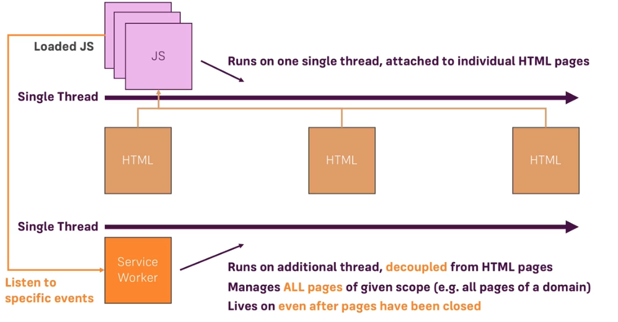
Doing Work Behind the Scenes

Slide 21
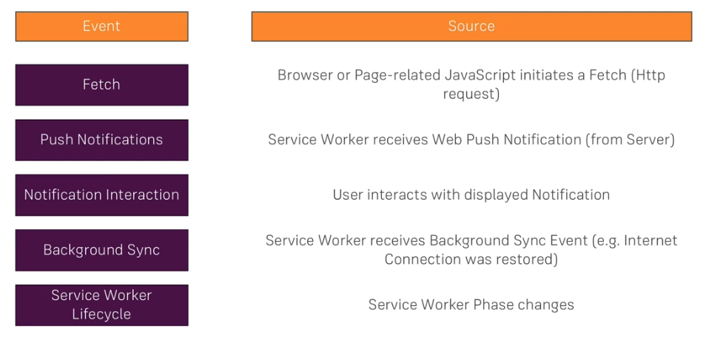
“Listenable” Events in Service Worker

Slide 22
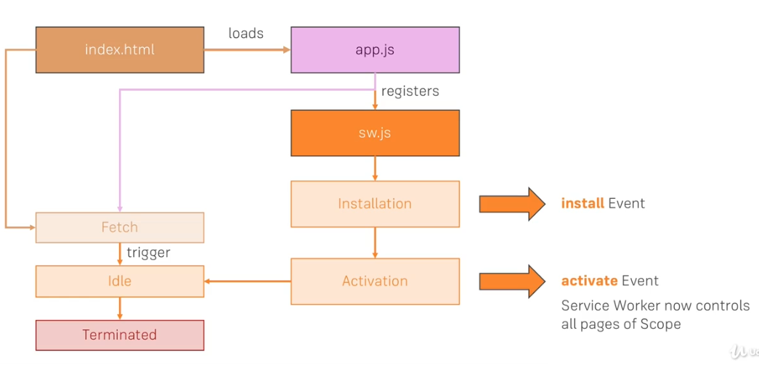
Service Worker Lifecycle

Slide 23
Outline
Getting Started
Understanding App Manifest
The Service Workers
Promise and Fetch
Service Workers - Caching
Service Workers - Advanced Caching
IndexedDB and Dynamic Data

Slide 24
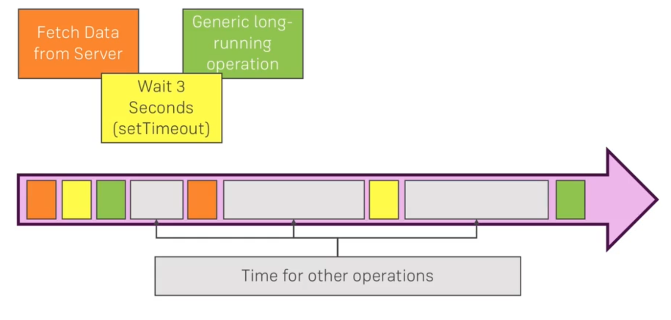
Foundational Building Blocks

Slide 25
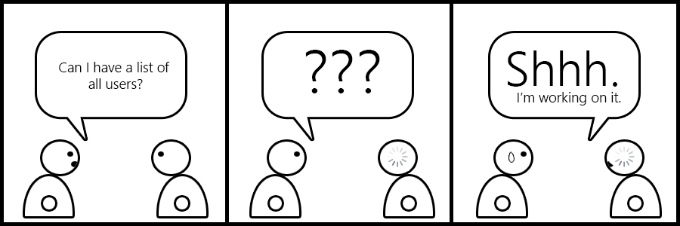
Promise

Slide 26
Outline
Getting Started
Understanding App Manifest
The Service Workers
Promise and Fetch
Service Workers - Caching
Service Workers - Advanced Caching
IndexedDB and Dynamic Data

Slide 27
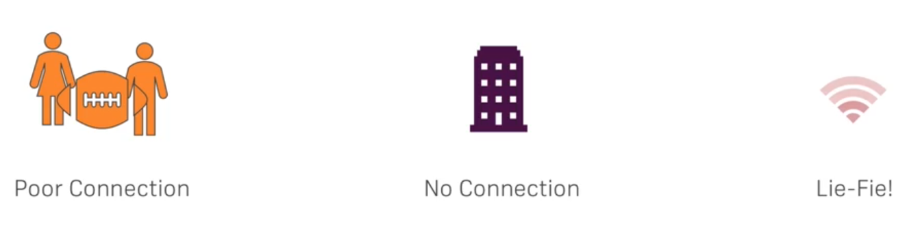
Providing Offline Support

Slide 28
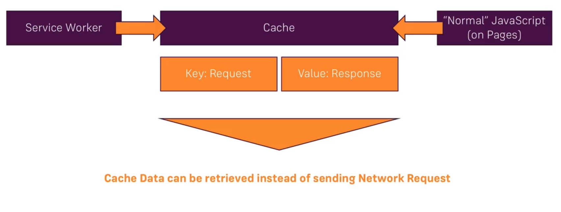
Cache API

Slide 29
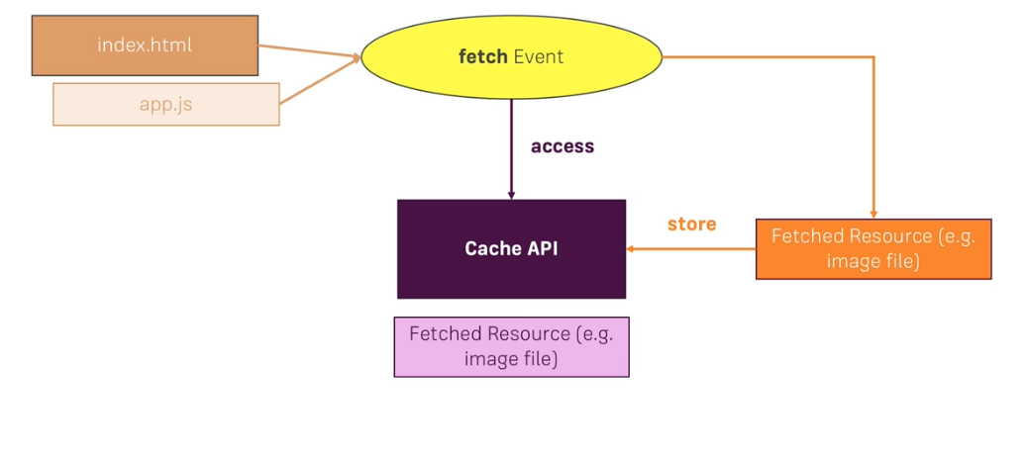
Dynamic Caching

